Slide 1
Entrance Activity:
Make a list of things that are annoying, but are more serious, for example, global warming, school uniform, media obsession with weight, etc.

Slide 2
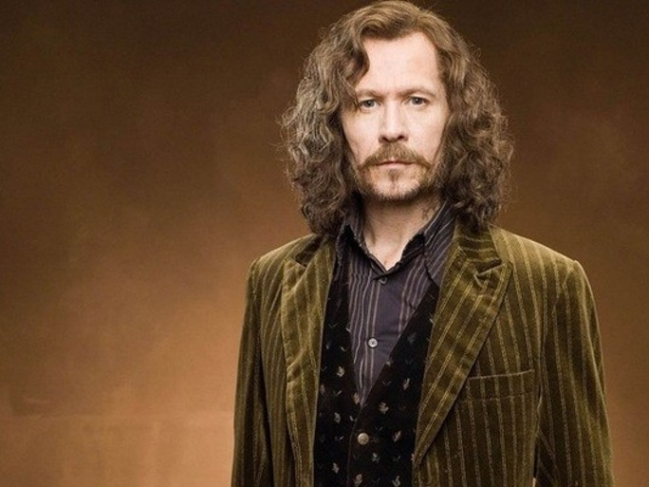
Title: Serious Writing
English Language GCSE Paper 2: Writer’s Viewpoints and Perspectives
Section B: Writing to present a viewpoint
Aims:
To have identified the features of serious writing
To have assessed their effectiveness using AfL
Notes:
Sirius writing. Ha.

Slide 3
Serious or funny?
Look at the topics listed and decide whether you would be able to write a funny article or if it would need to be serious, or both!
Footballers Pay Social Networking
Are models too thin? The right to die
Capital punishment Knife Crime
Making people volunteer Sharing films online
Students repeating a year Single sex schools

Slide 4
What makes the difference?
Topics covered
Words used
Structure
Names
Description
Reader’s reaction
Writer’s intentions

Slide 5
Read the article and then answer the following questions:
1. What is the article about?
2. What is the headline of the article?
3. What factual information is contained in the article?
4. What opinions are included?
5. What is the effect of using lots of short paragraphs?
Notes:
Paper copies of the questions available. Can be used with ANY newspaper article on a serious subject.

Slide 6
6. What is the effect of using quotations in the article?
7. What is the effect of using bullet points?
8. What sub-heading is used in the article and what is the effect of having a sub-heading?
9. Which people are named in this article and why is it a good idea to have named people in an article like this one?

Slide 7
10. Compared to the humorous article you looked at, what makes this a serious article? Think about:
the language used
the use of facts/opinions
the use of named people
what the material is about.
11. Having read this article, what is your opinion on the subject?
Notes:
10 links to Q4 looking at comparison of language techniques

Slide 8
Make a brief plan, using the concept map below, on what you might say, in a serious manner, on this topic.

Slide 9
Plenary
Now that you have analysed the serious article, you need to re-write at least the first two paragraphs in a HUMOROUS way.
You should aim to write up to 200 words.
Remember to use language for impact
Rewrite the title to include humour

