Slide 1
HOW DOES PRIESTLEY SHOW THAT TENSION IS AT THE HEART OF THE BIRLING FAMILY?

Slide 2
3 Unities
Time – it’s real time so we experience everything that happens to them
Place - intimate setting therefore we see everything they don’t want us to see, so they are exposed
Action – chain of events – responsibility – cause and effect

Slide 3
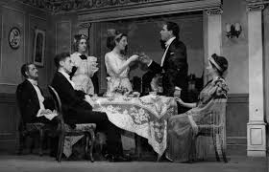
Stage directions
Priestley has set the scene to make the house look grand and well kept, it is not ‘homelike’. The appearance may be well kept but they may not show each other the love and support they need. ‘Substantial and heavily comfortable but not cosy and homelike’.

Slide 4
Dramatic irony
Birling believes that society is heading for a time of ‘increasing prosperity’ and that the ‘Germans don’t want war’. The audience however knows that war is just round the corner.
Priestley uses the dramatic irony to show that Mr Birling is stubborn in his beliefs. He’s not in contact with the rest of the world including his family.

Slide 5
The inspector
The role of the inspector is to uncover secrets and the truth. By bringing him into the dining room which is the heart of the Birling home, Priestley shows that there are hidden truths and secrets at the heart of the Birling family.
In the first description, Priestley describes the lighting should be ‘pink and intimate until the inspector arrives, and then it should be brighter and harder’. The lighting is a dramatic technique; the pink light creates a light hearted atmosphere but when the inspector arrives the light is brighter and harder as if the truth is coming out. The light shows what is hidden. The family has been living in the dark about each others secrets.

Slide 6
Learning ladder
This is an unexpected denouement.
A*
This releases some of the tension but the final telephone call announcing that the real inspector was on his way to ask questions about the suicide of a young girl, tension is restored.
A
In act 3 Birling's believe themselves to be off the hook when it is discovered that the inspector wasn’t real and no girl had died in the infirmary.
B
C
Cliff-hanger endings.

Slide 7
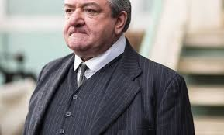
Tone
There are numerous changes in tone throughout the play. For example, Mr Birling’s confidence is soon replaced – first by self justification and then trying to justify and explain his role in Eva’s death and then by anxiety.

