Slide 1
An Introduction to Tragedy
Elizabethan
Jacobean
Revenge Tragedy

Slide 2
Elizabethan Drama is simply the genre of theatre originating in England during the latter half of the 16th Century, being written and performed chiefly during the reign of Queen Elizabeth I from 1558-1603. It includes, but is in no way limited to, the works of William Shakespeare (his historical plays and comedies as well as his tragedies). “Elizabethan” Tragedy Elizabethan tragedy differs from Aristotelian tragedy in that it originally was didactic (instructional) a warning against the dangers of tyranny, usurpation, and political unrest. (BC 162)” ie Early Greek Tragedy was very POLITICAL, not PERSONAL – many of Shakespeare’s tragedies are BOTH

Slide 3
Elements of TRAGEDY

Slide 4
1. Tragedy must end in some tremendous catastrophe involving in Elizabethan practice the death of the principal character.

Slide 5
2. The catastrophe must not be the result of mere accident, but must be brought about by some essential trait in the character of the hero acting either directly or through its effect on other persons.

Slide 6
3. The hero must nevertheless have in him something which outweighs his defects and interests us in him so that we care for his fate more than for anything else in the play. The problem then is, why should a picture of the misfortunes of some one in whom we are thus interested afford us any satisfaction? No final answer has yet been found. Aristotle said that the spectacle by rousing in us pity and fear purges us of these emotions, and this remains the best explanation. Just as a great calamity sweeps from our minds the petty irritations of our common life, so the flood of emotion lifts us above them.

Slide 7
More specifically referred to as "a tragic hero" in Elizabethan Tragedy. The death of a tragic hero never comes easily or quickly. Instead a troubled part of the hero's life leads up to his death. The suffering and calamity of the hero must also be of an exceptional nature. In other words an essentially previous happy existence must be shattered by some unforeseen calamity. "A total reverse of fortune, coming unawares upon a man who stood in high degree, happy and apparently secure, - such was the tragic fact to the medieval mind."

Slide 8
Introduction to the Elizabethan Revenge Tragedy Thomas Kyd established the revenge tragedy with his wildly popular Spanish Tragedy (1587), and Shakespeare perfected the genre with Hamlet, which is likely based on another revenge play by Kyd called the Ur-Hamlet. Sadly, no copy of Kyd's Ur-Hamlet exists today. Most revenge tragedies share some basic elements: a play within a play, mad scenes, a vengeful ghost, one or several gory scenes, and, most importantly, a central character who has a serious grievance against a formidable opponent. This central character takes matters into his own hands and seeks revenge privately, after justice has failed him in the public arena. It should be noted that Hamlet is the only protagonist in any Elizabethan revenge play who can be considered a hero, aware of the moral implications involved in exacting his revenge.

Slide 9
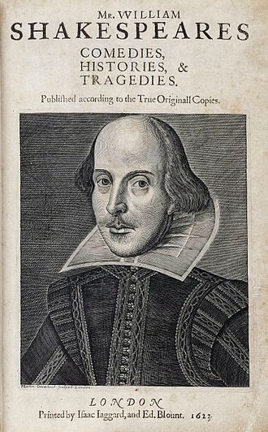

Slide 10
Revenge Tragedy
A style of drama, popular in England during the late 16th and 17th centuries, in which the basic plot was a quest for vengeance and which typically featured scenes of carnage and mutilation. Examples of the genre include Thomas Kyd's The Spanish Tragedy (1592) and John Webster'sThe Duchess Of Malfi (1623).

Slide 11
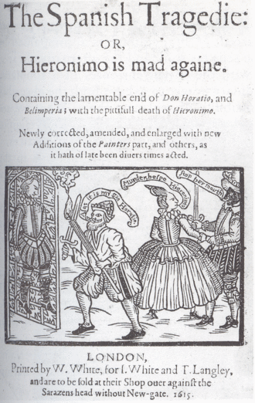

Slide 12
If we want to look in another direction for the meaning of tragedy, we can look at the hero himself. Are there any common qualities that seem to apply to most of the tragic heroes in Shakespeare? One obvious characteristic is that they are all great or exceptional persons, person of high degree and/or public importance. Besides this, however, their nature must be exceptional and must generally raise them above the general of humanity. These characters must be paragons of mankind; however, but must have at least one trait, referred to as "a tragic flaw", which leads to their downfall. Because of this one trait, they are unable to resist or are often unconscious of a breach of right; in some it is accompanied by full conviction of right.

Slide 13
“Revenge” Tragedy In Elizabethan revenge tragedy, someone (usually the hero) attempts to right a wrong, and in the attempt, brings about his own bloody downfall as well as downfall of the wrong-doer. The desire for revenge often caused the character's madness and/or death since revenge is rightly the province of God rather than humans.” A brief definition of Elizabethan Tragedy: “The distinction between tragedy and comedy, still useful in our age, was particularly important in Shakespeare's time. Elizabethan tragedy was the still familiar tale of a great man or woman brought low through hubris or fate (though some of Shakespeare's tragic heroes--Romeo, say, or Timon, or Macbeth--do not easily accommodate Aristotle's definition of the type).”

Slide 14
Shakespeare's Audience Most of the poorer audience members, referred to as groundlings, would pay one penny (which was almost an entire day's wage) to stand in front of the stage, while the richer patrons would sit in the covered galleries, paying as much as half a crown each for their seats. In 1599, Thomas Platter, a Swiss doctor visiting London from Basel, reported the cost of admission in his diary: "[There are] separate galleries and there one stands more comfortably and moreover can sit, but one pays more for it. Thus anyone who remains on the level standing pays only one English penny: but if he wants to sit, he is let in at a farther door, and there he gives another penny. If he desires to sit on a cushion in the most comfortable place of all, where he not only sees everything well, but can also be seen then he gives yet another English penny at another door. And in the pauses of the comedy food and drink are carried round amongst the people and one can thus refresh himself at his own cost." (Diary of Thomas Platter)

