Slide 1
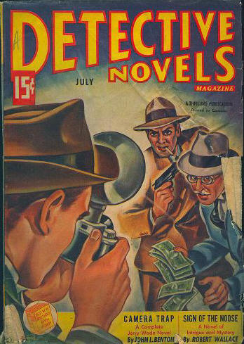
Attitudes to the Crime Genre

Slide 2
The discrepancy between taste and acclaim Attitudes to Crime fiction Up to the 1960s or so, reading the paperback edition of a crime novel was usually considered a cheap thrill—with the word "cheap" used in both meanings: "inexpensive" and "of minor quality". The educated and civilized world was often interested, at least ostensibly, in the "high art" categorised by classical music, paintings by renowned artists, famous literature and plays like those of William Shakespeare. The term "popular art" referred to folk music, jazz, or rock 'n' roll, photography, the design of everyday objects, comics, science fiction, detective stories or erotic fiction (the latter circulating in private prints only to beat the censor), to quote a few examples.

Slide 3
The idea of a "main stream" of literary output suggested that any book deviating, in either content or form or both, from the established norm of "high art" was "cheap", and anyone interested in popular culture was uneducated and unsophisticated and most probably originated in a lower socio-economic division of the contextual society. The universities and the other institutions of higher learning also looked down on artists producing "popular art" and categorically refused to critically assess it. This often did not correlate with the immense popularity of popular art on both sides of the Atlantic, sometimes due to sensationalism. For example, the British had been fascinated by Edgar Wallace's (1875–1932) crime novels ever since the author set up a competition offering a reward to any reader who could figure out and describe just how the murder in his first book, The Four Just Men (1906), was committed.

Slide 4
The Golden Age of crime fiction
The 1920s and 30s are commonly known as the "Golden Age" of detective fiction. Most of its authors were British: Agatha Christie (1890–1976), Dorothy L. Sayers (1893–1957), and many more. Some of them were American, but with a British touch. By that time certain conventions and clichés had been established which limited any surprises on the part of the reader to the twists and turns within the plot and of course to the identity of the murderer. The majority of novels of that era were whodunnits, and several authors excelled, after successfully leading their readers on the wrong track, in convincingly revealing to them the least likely suspect as the real villain of the story. What is more, they had a predilection for certain casts of characters and certain settings, with the secluded English country house at the top of the list.
A typical plot of the Golden Age mystery followed these lines:
A body, preferably that of a stranger, is found in the library by a maid who has just come in to dust the furniture.
As it happens, a few guests have just arrived for a weekend in the country—people who may or may not know each other. They typically include such stock characters as a handsome young gentleman and his beautiful and rich fiancée, an actress with past glory and an alcoholic husband, a clumsy aspiring young author, a retired colonel, a quiet middle-aged man no one knows anything about who is supposedly the host's old friend, but behaves suspsiciously and a famous detective.
The police are either unavailable or incompetent to lead the investigation for the time being.

Slide 5
A reassessment of critical ideals By the 1970’s attitudes were changing towards high art and low art. In the long run, the vast output of popular fiction could no longer be ignored, and literary critics—gradually, carefully and tentatively—started questioning and assessing the complete notion of the perceived gap between "high art" (or "serious literature") and "popular art" (in America often referred to as "pulp fiction", often verging on "smut and filth"). One of the first scholars to do so was American critic Leslie Fiedler. In his book Cross the Border—Close the Gap (1972), he advocates a thorough re-assessment of science fiction, the western, and all the other subgenres that previously had not been considered as "high art", and their inclusion in the literary canon

Slide 6
According to Fiedler, it was also up to the critics to reassess already existing literature. In the case of U.S. crime fiction, writers that so far had been regarded as the authors of nothing but "pulp fiction"—Raymond Chandler, Dashiell Hammett, James M. Cain, and others—were gradually seen in a new light. Today, Chandler's creation, private eye Philip Marlowe—who appears, for example, in his novels The Big Sleep (1939) and Farewell, My Lovely (1940)—has achieved cult status and has also been made the topic of literary seminars at universities round the world, whereas on first publication Chandler's novels were seen as little more than cheap entertainment for the uneducated masses.

Slide 7
Hard boiled American crime fiction writing A U.S. reaction, to the cosy conventionality of British murder mysteries, was the American hard-boiled school of crime writing (certain works in the field are also referred to as noir fiction). Writers like Dashiell Hammett (1894–1961), Raymond Chandler (1888–1959), Jonathan Latimer (1906–1983), Mickey Spillane (1918–2006), and many others decided on an altogether different, innovative approach to crime fiction. This created whole new stereotypes of crime fiction writing. The typical American investigator in these novels, was modeled thus: He works alone. He is between 35 and 45 years or so, and both a loner and a tough guy. His usual diet consists of fried eggs, black coffee and cigarettes. He hangs out at shady all-night bars. He is a heavy drinker but always aware of his surroundings and able to fight back when attacked. He always "wears" a gun. He shoots criminals or takes a beating if it helps him solve a case. He is always poor. Cases that at first seem straightforward, often turn out to be quite complicated, forcing him to embark on an odyssey through the urban landscape. He is involved with organized crime and other lowlifes on the "mean streets" of, preferably Los Angeles, San Francisco, New York, or Chicago. A hard-boiled private eye has an ambivalent attitude towards the police. It is his ambition to save America and rid it of its mean elements all by himself.

Slide 8
Modern crime writing
A shift from plot-driven themes to character analysis
Over the decades, the detective story metamorphosed into the crime novel.
Starting with writers like Francis Iles, who has been described as "the father of the psychological suspense novel as we know it today," more and more authors laid the emphasis on character rather than plot. Up to the present, lots of authors have tried their hand at writing novels where the identity of the criminal is known to the reader right from the start. The suspense is created by the author having the reader share the perpetrator's thoughts—up to a point, that is—and having them guess what is going to happen next (for example, another murder, or a potential victim making a fatal mistake), and if the criminal will be brought to justice in the end.

Slide 9
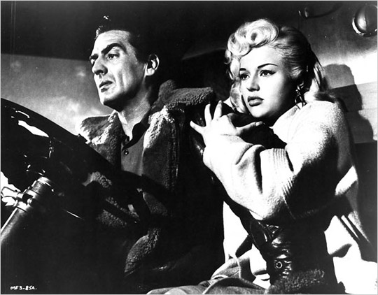

Slide 10
