Slide 1
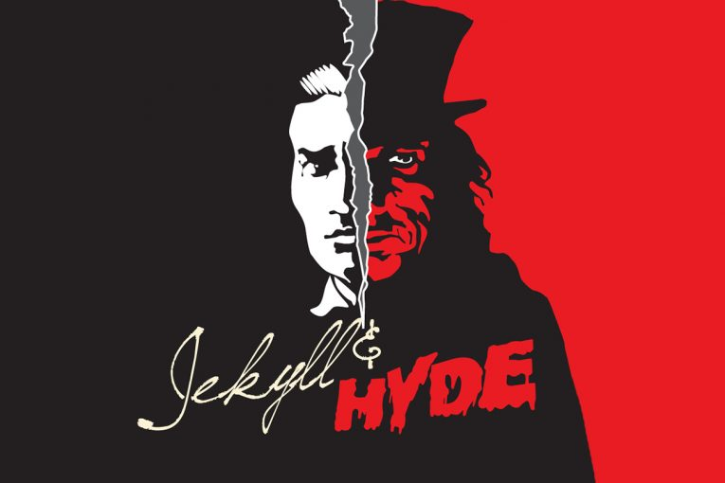

Slide 2
Key quotes to Change your life !

Slide 3
Proceed by mouse click – if you dare !

Slide 4
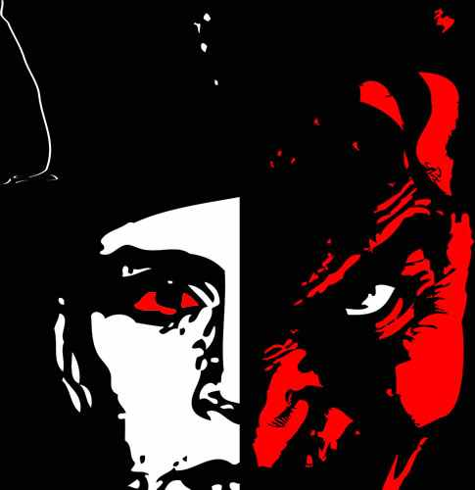
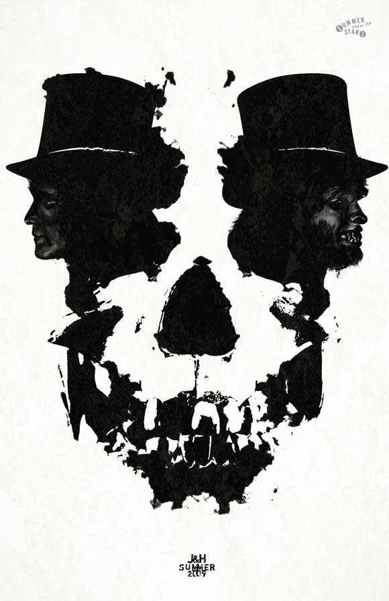
Theme: Personification, foreshadowing Hyde, Contrasts
Chapter 1:
“a certain sinister block of building thrust forward”

Slide 5
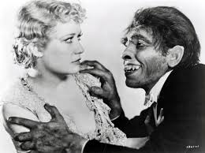
Theme: Superstition, Religion, “Otherness”
Chapter 1:Enfield Describes Hyde:“a really damnable man…..a strong feeling of deformity”

Slide 6
Theme: Superstition, Religion, “Otherness”
Chapter 1:Enfield Describes Hyde:“ Like some damned juggernaut”

Slide 7
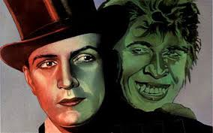
Theme: Deformity, Religion, foreshadowing
Chapter 2: More on Hyde: “Mr Hyde was pale and dwarfish”, “Murderous mixture” “Foul Soul”

Slide 8
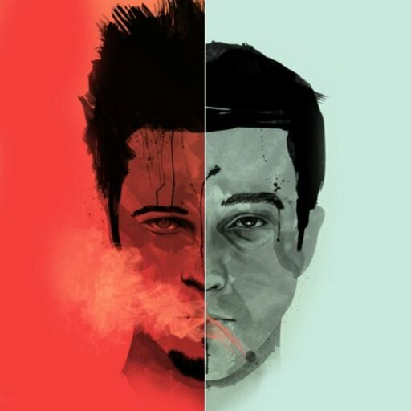
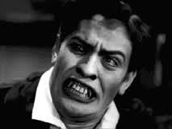
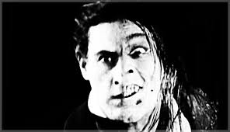
Theme: Religion, Hyde as symbol of Evil
Chapter 2: Utterson on meeting Hyde: “Satan’s signature on a face”

Slide 9
Theme: Violence, Evil, Duality, breaking society’s codes
Chapter 4: Carew Murder Case, more on Hyde: “broke out of all bounds”

Slide 10
Theme: Violence, Evil, Duality, Symbolism
Chapter 4: Carew Murder Case, broken cane as symbol of split personality: “Cane had broken……….one splintered half”

Slide 11
Theme: novel reveals social conditions of poverty, pathetic fallacy, Victorian fear of sex (Soho)
Chapter 4: Carew Murder Case – journey to Soho – pathetic fallacy: “A haggard shaft of daylight” “A dismal quarter of Soho”

Slide 12
Theme: novel reveals social conditions of poverty, pathetic fallacy, Victorian fear of sex (Soho)
Chapter 4: Carew Murder Case – journey to Soho – pathetic fallacy: “The fog settled down again” – fog a symbol of secrecy

Slide 13
Theme: Animalism, Victorian fear over Theory of Evolution, Fear of “Lower orders” – like animals
Chapter 8: The Last Night, Poole on Hyde: “When that masked thing, like a monkey”

Slide 14
Theme: Transformation, Duality
Chapter 9: Lanyon’s Narrative: “His face became suddenly black and his features seemed to melt and alter”

Slide 15
Theme: Chapter 10 – key ideas on Sin, Duality, “respectability”
Chapter 10: The attraction of Hyde to Jekyll: “ I felt younger , lighter, happier……a heady recklessness”

Slide 16
Theme: Chapter 10 – key ideas on Sin, Duality, “respectability”
Chapter 10: Jekyll: “Man is not truly one, but truly two”

Slide 17
Theme: Chapter 10 – key ideas on Sin, Duality, “respectability”
Chapter 10: Jekyll: “The animal within me, licking the chops of memory”

Slide 18
Theme: Chapter 10 – key ideas on Sin, Duality, “respectability”
Chapter 10: Jekyll: “To assume, like a thick cloak, that of Edward Hyde”

Slide 19
Theme: Chapter 10 – key ideas on Sin, Duality, “respectability”
Chapter 10: Jekyll: “All Human beings are commingled out of good and evil”

Slide 20
Theme: Chapter 10 – key ideas on Sin, Duality, “respectability”, RELIGION
Chapter 10: Jekyll: “Instantly the spirit of hell awoke in me and raged”

Slide 21
Theme: Chapter 10 – key ideas on Sin, Duality, “respectability”, RELIGION, SUPPRESSED SEXUALITY, Hyde a symbol of deviant behaviour
Chapter 10: Jekyll: “My devil had long been caged, he came out roaring” – lack of sexual control?

Slide 22
Theme: Chapter 10 – key ideas on Sin, Duality, “respectability”,
Chapter 10: Jekyll: “I was so profound a double dealer”

Slide 23
Theme: Choice, Free Will
Chapter 10: Jekyll: “ But I had voluntarily stripped myself of these balancing instincts”

Slide 24
These are the Key Quotes that you need to succeed in the exam
Try to learn as many as you can
Remember: always be answering the question

Slide 25
Good Luck!

