Slide 1
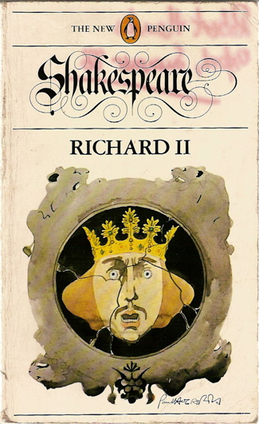
The Language of Richard II

Slide 2
Poetry (Blank Verse, Rhymed Couplets)
We've said it before and we'll say it again: Shakespeare wrote most of his plays in a combination of verse (poetry) and prose (the way we talk every day). In general, the upper class characters tend to speak verse, which is a formal way to talk. (The idea is that speaking verse fits their noble status.) On the other hand, commoners, or everyday Joes, tend to speak regular old prose (like us).
But... Richard II is the one exception to this rule. Almost the entire play is written in verse, which means that EVERYBODY speaks poetry, even the "lowly" gardeners.

Slide 3
Why?
There are boatloads of possible explanations, but here's how we see things. The world of Richard II is full of corruption, conspiracy, and hypocrisy. It seems artificial when everyone in the play runs around speaking in carefully constructed verse, which reminds us that hardly anyone can be trusted.
Of course, you've probably got more questions, like what kind of poetry does everybody speak? Wait, you weren't wondering that?
Well, we'll tell you anyway: usually blank verse a.k.a. unrhymed iambic pentameter. But there are also a lot of rhymed couplets in this play, too. What the heck are blank verse and rhymed couplets? you ask. Let's break it down:

Slide 4
Blank Verse (Unrhymed Iambic Pentameter)
Don't let the fancy names intimidate you – it's simple once you get the hang of it. Let's start with a definition of "iambic pentameter":
An "iamb" is an unaccented syllable followed by an accented one. "Penta" means "five," and "meter" refers to a regular rhythmic pattern. So "iambic pentameter" is a kind of rhythmic pattern that consist of five iambs per line. It's the most common rhythm in English poetry and sounds like five heartbeats:
da DUM, da DUM, da DUM, da DUM, da DUM.
Let's try it out on this line, where Richard fells sorry for himself:
I WASTEd TIME, and NOW doth TIME waste ME;
For NOW hath TIME made ME his NUMBering CLOCK:
Every second syllable is accented (stressed), so this is classic iambic pentameter. (Note: the word "numbering" is pronounced with only two syllables and sounds like "numb'ring.") Since the lines have no regular rhyme scheme, we call it unrhymed iambic pentameter, or blank verse.

Slide 5
Rhymed Couplets in Iambic Pentameter
A "rhymed couplet" is just two lines of verse that rhyme at the end. Take these two lines from Act 1, Scene 1, where Mowbray defends himself against Bolingbroke's accusation of treason and the murder of Woodstock:
I am disgraced, impeached, and baffled here, Pierced to the soul with slander's venomed spear,
Why so many rhymed couplets in this play? Some scholars think it had to do with Shakespeare's recent experiments in sonnet-writing. (Shakespeare's sonnets always end with a rhymed couplet).
Was Shakespeare just on a big rhyming kick? Or was he trying to show us how good some characters are at controlling their language? For instance, Mowbray, Richard II, and Henry are really good at composing tight couplets when they're talking about Henry Bolingbroke's challenge to Mowbray in Act 1, Scene 1.

Slide 6
Let's think about this for a minute. Everyone (including Richard) knows that when Bolingbroke accuses Mowbray of treason and the murder of Woodstock, he is really accusing King Richard of killing Woodstock. Bolingbroke can't say anything bad against the king, though, and the king can't acknowledge what's happening without fessing up to murdering his uncle.
When these guys (who are all being pretty dishonest here) start talking in rhymed couplets all of sudden, we wonder if they're just hiding behind fancy speech.

Slide 7
ANALYSIS: WHAT'S UP WITH THE TITLE?
What's up with the title? You know the answer to this. There's a king named Richard II... but he won't be a king for long. That's why the publishers of the first quarto edition of the play (printed in 1597) called it The Tragedy of Richard II. The tragedy being that Richard gets knocked off the English throne and tossed in the slammer where he has an emotional meltdown right before he's murdered. What's interesting is that, later, when the first folio edition of the play (printed in 1623) came out, it was called The Life and Death of King Richard the Second. (Check out the title page on next slide)
What does this title change tell us? Well, the folio publishers probably thought of the work as more of a history play than a tragedy. We talk about all this tragedy vs. history stuff in "Genre," so go there if you want to know more.

Slide 8
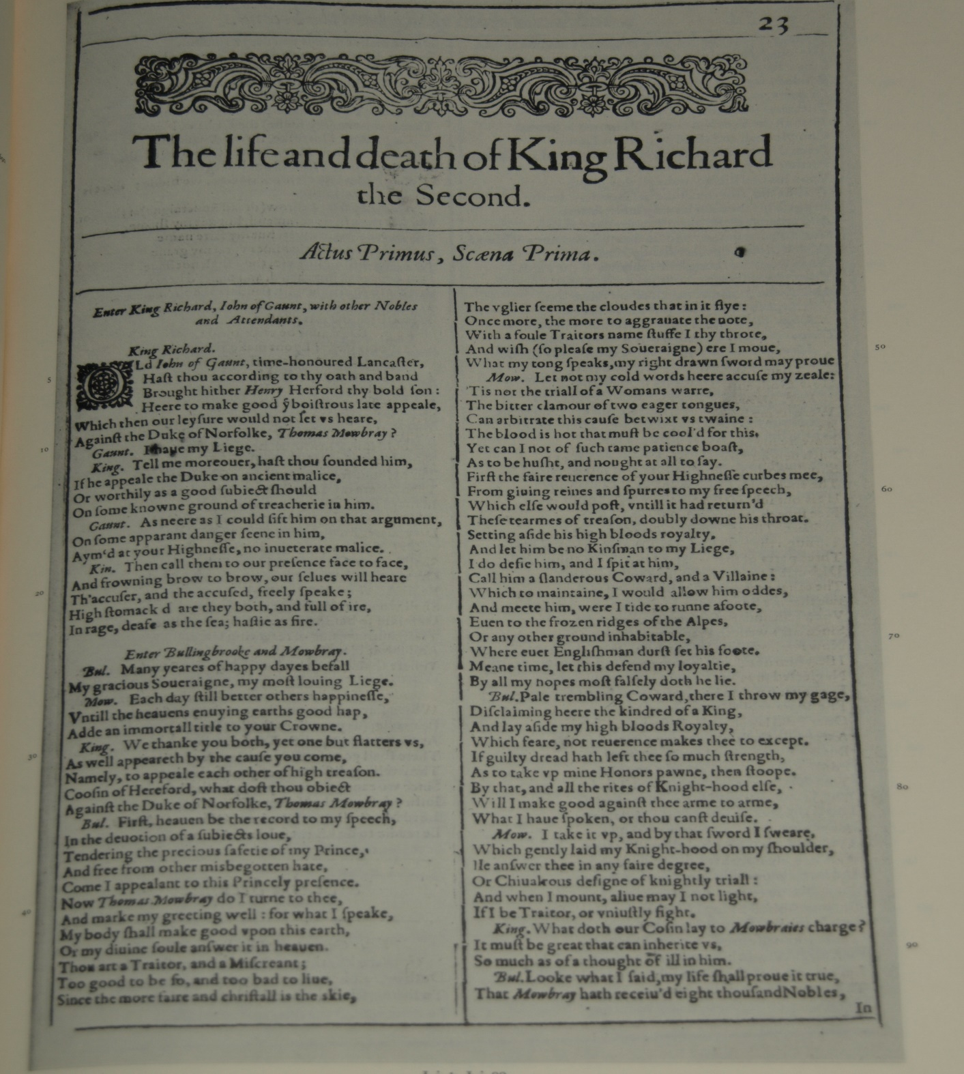

Slide 9
ANALYSIS: WHAT'S UP WITH THE ENDING?
If we were going to rank the ending of this play on a Depression Scale of 1 to 10, with 10 being the biggest downer ever, we'd give Richard II a 9. It's not as dark as, say, King Lear, but it's right up there with the ending of Hamlet.
Why? For one thing, the play closes with Richard's coffin onstage. Hello! This is not a good sign because it 1) reminds the audience of the poor guy's suffering and 2) suggests that there's even more death and suffering to come throughout England.

Slide 10
Road Trip to the Holy Land
It's no wonder that the newly crowned king (that would be King Henry IV) is feeling all guilty at the end of the play. After all, Henry's the one who stole Richard's crown and locked him up in prison. He also hinted to one of his henchmen that Richard should be murdered. So what does Henry do when he sees Richard's coffin? He decides to go on a pilgrimage to try to make up for his sins.
At first Henry's road trip to the Holy Land (a.k.a. Jerusalem) sounds like a nice idea... until we figure out what he actually means, when he says, "I'll make a voyage to the Holy Land, / To wash this blood off from my guilty hand" (5.6.6). Translation: Henry is going to start a holy war to try to make up for his actions against the former king. More bloodshed to make up for previous bloodshed? This doesn't sound good at all.

Slide 11
The Next King of England
Oh, did we mention that King Henry IV is also worried about his rotten, good-for-nothing son, Prince Hal, who is set to inherit the throne when Henry dies? Well, he is. Check out what Henry says in one of the last scenes of the play:
Can no man tell me of my unthrifty son? 'Tis full three months since I did see him last; If any plague hang over us, 'tis he. I would to God, my lords, he might be found: Inquire at London, 'mongst the taverns there, For there, they say, he daily doth frequent, With unrestrained loose companions, Even such, they say, as stand in narrow lanes, And beat our watch, and rob our passengers; (5.3.1)

Slide 12
Wow – no sooner has Henry IV come into power than Shakespeare is bringing up the question of who will take his place when he dies. The fact that the heir to the throne is nowhere to be found because he spends all his time in bars and brothels with his thieving friends sets off some warning bells, wouldn't you say? (By the way, if you want to know what happens with Prince Hal, you'll have to read Henry IV Part 1.)

Slide 13
Why does Shakespeare Make the Ending Such a downer?
We know what you're probably thinking Richard was a pretty lousy king. He almost bankrupted England, had his own uncle murdered, and thought nothing of stealing from the members of the nobility.
So why doesn't Shakespeare throw the newly crowned King Henry IV a big parade or something for taking Richard down? There are a few reasons. Historically speaking, after Richard's death, Henry IV's reign was plagued by all sorts of problems – namely, civil warfare.

Slide 14
The other issue is that Henry IV didn't exactly take the traditional route to kingship. Like we've said elsewhere, kings were supposed to inherit the crown (ideally from their fathers), not just snatch it away from an existing ruler because they felt like it.
Plus, Henry IV has just eliminated a king who many believed was hand-picked by God to rule England. Even though it seems like Henry IV will probably be a more capable monarch than Richard ever was, he's also considered a rebel and a sinner.
More important, he has just opened the floodgates for even more rebellion, which Shakespeare covers in the next two plays of the series.

Slide 15
ANALYSIS: BOOKER'S SEVEN BASIC PLOTS ANALYSIS
Christopher Booker is a scholar who wrote that every story falls into one of seven basic plot structures: Overcoming the Monster, Rags to Riches, the Quest, Voyage and Return, Comedy, Tragedy, and Rebirth. Which of these structures fits this story like Cinderella’s slipper ?

Slide 16
Plot Type : Tragedy
Note: Like a lot of scholars, Christopher Booker identifies Richard II as a tragedy, but the play also falls into the genre of history play

Slide 17
Anticipation Stage
Richard has emptied out his royal checking account and needs money to fund the wars in Ireland. He's pretty pleased with life, though: as a monarch chosen by God, he thinks he's pretty awesome, and so does everyone around him, since he only surrounds himself with flatterers. Life is good for Richard.
Richard might be said to suffer from an excess of self-esteem. He thinks he's just as great as all his yes-men say, and as a result he feels like he can do whatever he wants.

Slide 18
Dream Stage
When Bolingbroke accuses Mowbray of killing Gloucester (a murder Richard seems to have ordered), Richard tries to get them to be friends. When that doesn't work, he banishes them both. When Gaunt dies, Richard is totally psyched, since Gaunt had a lot of property. He seizes it to help fund the wars.
Everything seems to be going very well for Richard! The annoying uncle who insulted him has died, leaving all his riches behind. Since Richard banished his heir, Bolingbroke isn't around to try to interfere with Richard's plan to steal Gaunt's property.

Slide 19
Frustration Stage
Unfortunately, at this point another uncle decides to pipe up and criticize Richard. York, who's always done what Richard told him to, tells Richard he can't take it anymore and that it's wrong to take Bolingbroke's property. Richard ignores him and goes off to Ireland to fight.
This is the point when things start to go badly for Richard. If even yes-man York is freaked out by what he's doing to Bolingbroke, then the rest of the nobles must be pretty convinced that Richard is treating Bolingbroke not just badly but illegally. Public opinion is turning against Richard, and everyone thinks Bolingbroke has a pretty good case for coming back to claim what's his.

Slide 20
Nightmare Stage
Sure enough, Bolingbroke comes back. Richard is so far away that communication isn't really happening between him and York. The tide is turning against him. People think Bolingbroke deserves his inheritance, and a rumour starts to spread that Richard is dead. Shortly after Richard comes back, Bolingbroke captures him and Richard hands him the crown.
Richard's overconfidence in his subjects' loyalty and in his own godlike status leads him to neglect his kingdom. By the time he decides to do something about it, it's too late: Bolingbroke has total control.

Slide 21
Destruction or death wish Stage
King Henry gets down to the business of ruling England. Richard mopes for a while until he's finally killed by Sir Piers Exton and his henchmen.
There's some poetic justice in the way Richard dies: he's murdered in the same way Gloucester seems to have been when he was Richard's captive: as a prisoner of the king, who might or might not have directly ordered his death. The play ends with Richard's coffin onstage.

